Slide 1
Teams and teamwork
COMP1635 Professionalism In IT
Autumn Semester, 2016/17
Mrs Aditi Rawal

Slide 2
Teams and teamwork
Why have groups or teams?
‘Stages’ of team development
Characteristics of effective teams
Roles within teams
‘Ideal’ team composition for groupwork?

Slide 3
Why have teams?
To cope with:
volume of work
range of skills required
Other benefits:
cross-fertilization of ideas
share decision-making and the risk of the decision
enhance motivation - not to let the side down
support other team members when they need help
(based on Burke, 2013)

Slide 4
Stages of team development
Groups or teams tend to go through various stages of development
The productivity of the team will depend on the stage (of development) it has reached

Slide 5
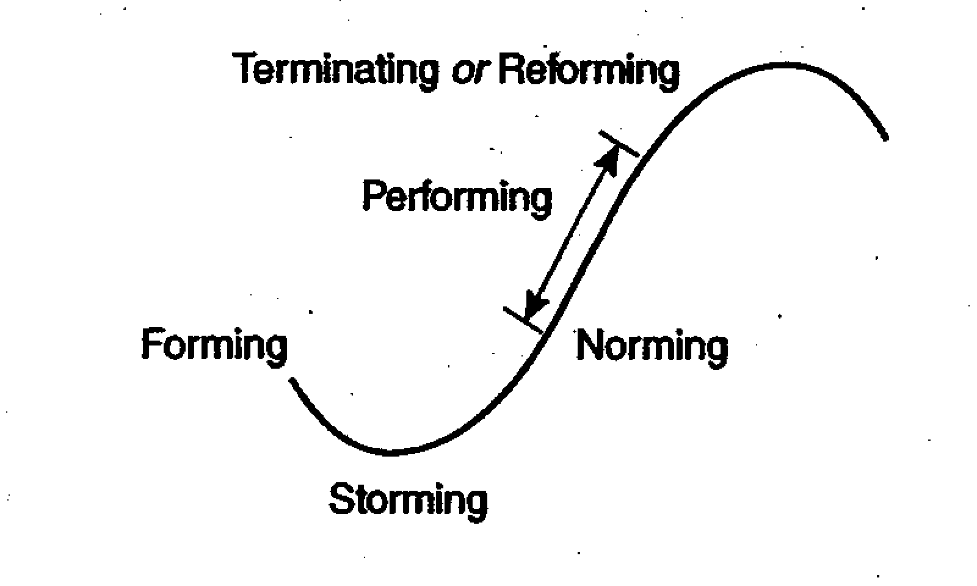
Four Phase Model Plotted on S Curve
Copyright © 2011 Pearson Education, Inc. All rights reserved.

Slide 6
Stages of team development
Forming (Dependency and Inclusion):
Individuals first come together to achieve project goals
Enthusiasm, conformity
Period of Observation
Getting to Know Other Group Members
Primary Tension, Uneasiness, Awkwardness
Rely on the leader (prefer directive style)
Finding out what is expected e.g goals
Assumption that there is consensus about goals
(Wheelan, 2009)

Slide 7
Stages of team development
Storming (Counter dependency and fight):
Find out where each other stand on issues
Conflicts about values emerge
Challenge leader and each other
Sub-groups and coalitions formed
Disagreement re goals/disillusionment with roles
Competition within the Group
Attempts at conflict management
(Wheelan, 2009)

Slide 8
Stages of team development
Norming (Trust and Structure):
Confidence and trust grows
Increased goal clarity and consensus
Communication content more task oriented
Team ‘norms’ agreed but sub-groups tolerated
Conflict managed more effectively
Build team structure to support goal achievement
Productivity starts to improve
(Wheelan, 2009)

Slide 9
Stages of team development
Performing (Work):
Whole is greater than the sum of the parts
Clarity of goals, assigned roles match member abilities
Team at its most productive
Leadership and responsibility shared
Appropriate ratio of task and supportive communication
(Wheelan, 2009)

Slide 10
Terminating Communication: A Sense of Closure
Sense of Accomplishment
Completion of the Task
Reflection on Task & Group Experience
Socio-Emotional Closure with Group Members

Slide 11
Teams and teamwork
Why have groups or teams?
‘Stages’ of team development
Characteristics of effective teams

Slide 12
Characteristics of effective teams
Effective teams comprise of people who are:
Knowledgeable about how groups operate
Knowledgeable about the tasks the group is charged with doing
(Wheelan, 1999, p.13)
Willing to contribute/reflect upon and improve contribution

Slide 13
Effective teams/ten keys to productivity
Clarity & agreement on team goals
Individual role clarity, agreement, ability and skills
Interdependence (task requires members to work together as unit and in subgroups)
Leadership style appropriate to group needs (stage of development)
Communication and feedback/utilising feedback

Slide 14
Effective teams/ten keys to productivity
Discussion, decision making and planning (plan how solve problems and make decisions, define and discuss problems that must solve)
Implementation and evaluation (accountability)
‘High performance’ norms and acceptance of individual differences
Appropriate structure
Cooperation and conflict management
(Wheelan, 2009)

Slide 15
Effective teams/characteristics of ‘winning’ teams
According to Belbin some or all of following characteristics are present in a successful team:
One chairperson type who encouraged all to contribute
At least one generator of innovative ideas
Spread of mental abilities
Spread of personalities
Team leader has appropriate management style for project, and ‘accepted’ by other team members
(based on Burke, 2013)

Slide 16
Roles within teams
One researcher Belbin has identified nine team roles
The “strengths” & “allowable weaknesses” are identified for each role type
Note that some “allowable weaknesses” are “strengths” taken to an extreme
...you can have too much of a good thing!

Slide 17
Belbin’s nine team roles
Initially Belbin proposed eight roles (1981)
Revised (1993) with an additional role:
specialist
and renaming two roles:
chairperson co-ordinator,
company worker implementer

Slide 18
Belbin’s nine team roles
Co-ordinator:
Good chairperson
Delegates well
Clarifies goals, promotes decision-making
Mature and confident
Can be seen as manipulative
Delegates personal work

Slide 19
Belbin’s nine team roles
Shaper:
Challenging and dynamic
Thrives on pressure
Has the drive and courage to overcome obstacles
Hurts people’s feelings
Can provoke others
(Belbin, 1993)

Slide 20
Belbin’s nine team roles
Plant/Innovator:
Generates ideas (imaginative)
Creative
Unorthodox
Solves difficult problems (lateral thinking)
Ignores details
Too preoccupied to communicate effectively

Slide 21
Belbin’s nine team roles
Monitor evaluator:
Strategic thinker
Good judgement
Sees all options
Sober
Lacks drive and doesn’t inspire others
Overly critical

Slide 22
Belbin’s nine team roles
Implementer:
Disciplined
Reliable, conservative and efficient
Turns ideas and plans into practical action
Somewhat inflexible
Slow to respond to new possibilities

Slide 23
Belbin’s nine team roles
Teamworker:
Co-operative, mild
Diplomatic
Listens, builds, averts friction
Perceptive
Indecisive in crunch situations
Can be easily influenced

Slide 24
Belbin’s nine team roles
Resource investigator:
Extrovert
Enthusiastic and explores opportunities
Good communicator
Develops contacts
Overoptimistic
Quickly loses interest once novelty has worn off (Belbin, 2012)

Slide 25
Belbin’s nine team roles
Completer:
Conscientious and painstaking
Anxious
Searches out errors and omissions
Delivers on time
Inclined to worry unduly and be a ‘nit-picker’
Reluctant to delegate

Slide 26
Belbin’s nine team roles
Specialist:
Self-starter and single-minded
Dedicated
Expert
Dwells on technicalities
Only contributes in areas of expertise
Overlooks ‘big picture’

Slide 27
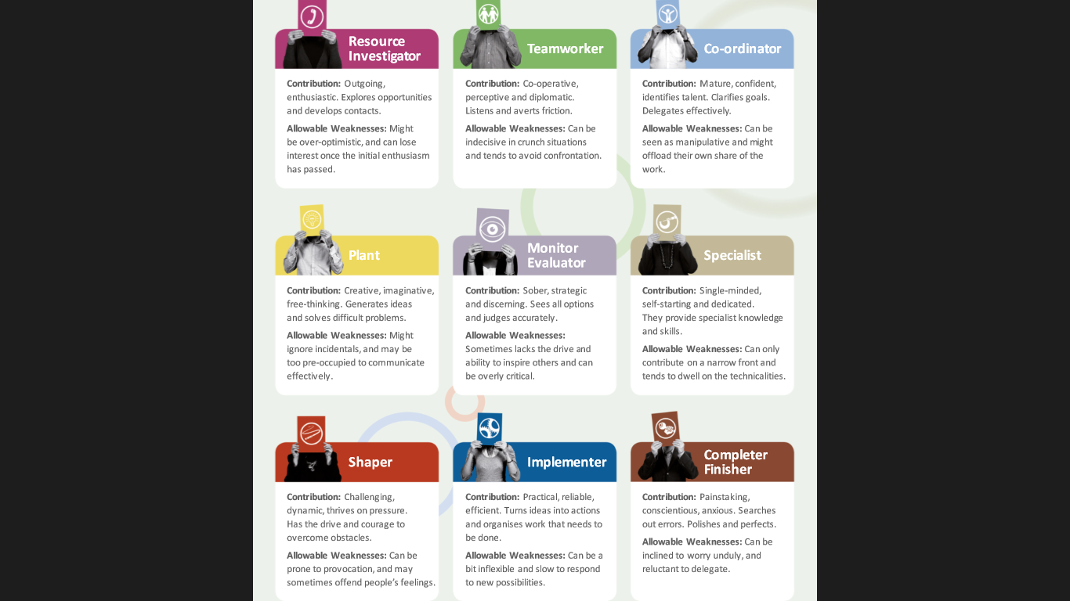
Belbin® Team Role Summary Descriptions

Slide 28
Teams and teamwork
Why have groups or teams?
‘Stages’ of team development
Characteristics of effective teams
Roles within teams
‘Ideal’ team composition for groupwork?

Slide 29
‘Ideal’ team composition for groupwork?
Might include:
Co-ordinator (chairperson) strengths
Ideas generator (plant/innovator) strengths
Team worker strengths
Completer strengths
Ultimately you decide!
(NB Wheelan suggests most reliable predictors of team success are knowledge about how groups operate and task knowledge (Wheelan, 2009)

Slide 30
Final note/Why teams fail?
Based on Belbin’s research Burke suggests that poor teams are not able to:
take advantage of opportunities
were poor at problem solving
unable to change with the times
could not work together
Could not communicate effectively
(Burke, 2013)

Slide 31
Conclusion
There aren’t good or bad Team roles but it is important for each person to know their own Team Roles and those of their colleagues with whom they interact.
It is only by making use of complementary and collective strengths that individuals and teams can achieve their full potential - in short;
Nobody's perfect, but a team can be.

Slide 32
References & further reading
BELBIN (2015) Belbin for students Download. Available at: http://www.belbin.com/media/1335/belbin-for-lecturers.pdf (Accessed: 2 August 2016).
Burke R. (2013) Project Management: Planning and Control Techniques. Wiley
Cottrell S. (2003) The Study Skills Handbook. Macmillan Press Ltd.
Maylor H. (1999). Project Management (2nd Edition). London: Pitman Publishing.
Race P. (2007). How to get a good degree, making the most of your time at university. Open University Press.
Wheelan S.A. (2009) Creating Effective Teams: A guide for members and leaders. Sage Publication Inc.

Slide 33
Week 3 Tutorial Task
1. Please read the Belbin Team roles document (Handout 1 on Moodle) and identify a team role (or two) you most resonate with.
2. You will be working in your teams (3/4 members in your group) on the Belbin team exercise (Handout 2). Use the Belbin Team Role Circle to enter the names of the team members on this with their corresponding roles.
a. Using their newly acquired knowledge of Team Roles, come up with a list of five strengths of the team, and five possible weaknesses. Please use Belbin Team Roles document (Handout 1) available on Moodle to facilitate the discussion.
3. Peer review your fellow team member’s contribution to group sessions, identifying two things he/she did well, and two things they could improve or develop.

Slide 34
Formative Feedback
Please use the tutorial session to get verbal formative feedback.
Use the end of lectures to ask questions and clarify your queries.
Please use the Office hours of the allocated Tutors to get verbal formative feedback.
Please use the allocated feedback session on Monday 31 October 2017. Please bring in your queries to the session. (Please note DO NOT email your work to tutors)

